Slide 1
Chapter 7
Sampling

Slide 2
Agenda
Populations and samples
Probability sampling techniques
Biased sampling techniques
Determining priorities
Next time on PSY 270…

Slide 3
Populations and Samples
Population – This is the entire set of people or things in which you are interested
  Ex: all freshman currently enrolled at UNK
Sample – This is a smaller set of people or things that is taken from the population
  Ex: 100 freshman currently enrolled at UNK
Census – If you sample every member of the population
Generalizability – To what extent does the sample represent the population?

Slide 4
Populations and Samples
Does our sample generalize to our population?
Does our sample represent the variability in our population?
Why do we need a large (enough) sample size?
  https://onlinestatbook.com/stat_sim/sampling_dist/

Slide 5
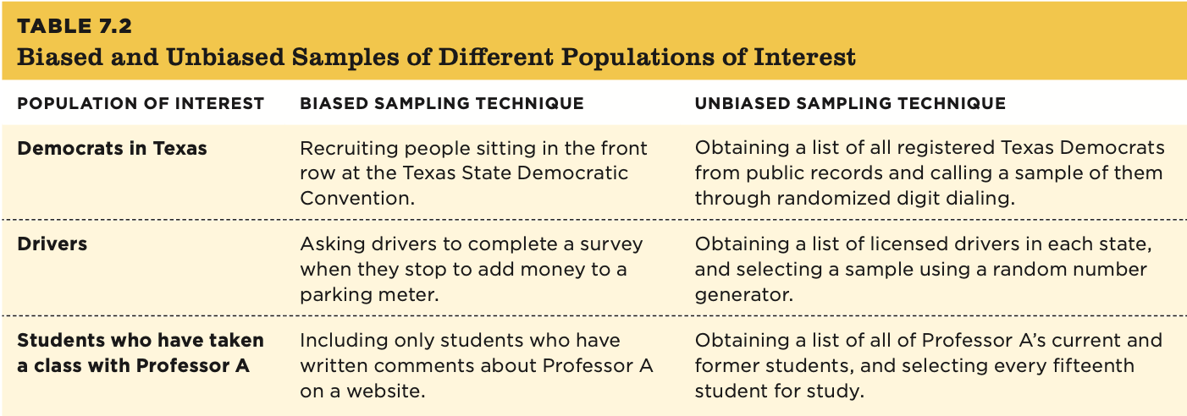
Coming from a Population Versus Generalizing to That Population

Slide 6
Probability Sampling

Slide 7
Probability Sampling
Probability sampling (also called random sampling) – Every member of the population of interest has an equal chance of being selected for the sample.
Simple random sampling – randomly sampling without any specific “rules” applied
  Ex: Putting every member’s name of your population of interest in a pool and then randomly selecting a predetermined number of names from the pool to include in your sample
Systematic sampling – creating “rules” for how you will randomly select participants
  Ex: If I wanted to systematically sample this class, I could roll two dice. Let’s say one lands on five and the other lands on three. I would start at the fifth person in the class and then choose every third person until the sample reached the desired size.

Slide 8
Probability Sampling
Cluster sampling – Clusters of participants within a population of interest are randomly selected, and then all individuals in each selected cluster are used.
  Ex: If a researcher wanted to randomly sample high school students in the state of Pennsylvania, for example, he could start with a list of the 952 public high schools (clusters) in that state, randomly select 100 of those high schools (clusters), and then include every student from each of those 100 schools in the sample.

Slide 9
Probability Sampling
Multistage sampling – When the randomization occurs at multiple steps (typically in 2 stages). Stage 1: A random sample of clusters is selected from your population of interest. Stage 2: From those selected clusters, a random sample of people is chosen.
  For example, a researcher starts with a list of high schools (clusters) in the state and selects a random 100 of those schools. Then, instead of selecting all students at each school, she selects a random sample of students from each of the 100 selected schools.

Slide 10
Probability Sampling
Stratified random sampling – A multistage technique in which the researcher selects specific demographic categories (such as race or gender) and then randomly selects individuals from each of the categories.
  Ex: a group of researchers might want to be sure their sample of 1,000 Canadians includes people of South Asian descent in the same proportion as in the Canadian population (which is 4%). Thus, they might have two categories (strata) in their population: South Asian Canadians and other Canadians.
Oversampling – a variation of stratified random sampling in which a researcher over represents one or more groups.
  For the example, it could mean increasing the proportion of South Asian participants to 10%

Slide 11
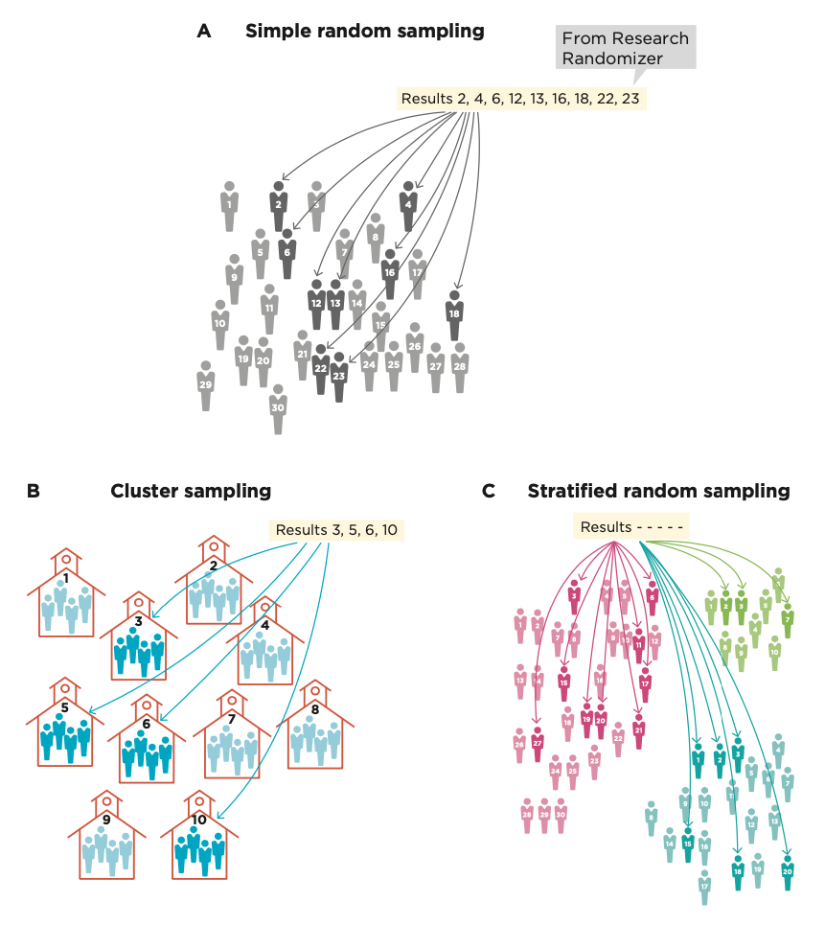
Probability Sampling

Slide 12
A Quick Note on Terminology
Random sampling – creating a sample using some random method so that each member of the population of interest has an equal chance of being in the sample; this method increases external validity.
  Increases external validity
Random assignment – only used in experiments; participants are randomly put into different groups (usually a treatment group and a comparison group); this method increases internal validity.
  Increases internal validity

Slide 13
Biased Sampling

Slide 14
Biased Sampling
Convenience sampling – Sampling only those who are easy to contact
Self-selection – Sampling only those who volunteer
Important note: Biased does NOT always equal bad. Remember, certain claims have different priorities in validities
  For a frequency claim, it is very important that your sample is unbiased (prioritizing external validity)
  For a causal claim, internal validity is the priority. There will be many more scenarios where you choose to have a biased sample on purpose
  The key is to understand what kind of claim you are making, and what you should prioritize accordingly

Slide 15
Biased Sampling Techniques
Purposive sampling – A sampling technique used when you want to study certain kinds of people, so you only recruit those types of participants.
  Ex: if you wanted to recruit smokers, you might recruit participants from a tobacco store.
Snowball sampling – A variation on purposive sampling in which participants are asked to recommend other participants for the study.
  Ex: if you wanted to recruit cancer survivors, you might ask a participant to recruit the survivors they know, then have their friends help recruit (and so on and so on)

Slide 16
Biased Sampling Techniques
Quota sampling – A technique similar to stratified random sampling; the researcher identifies subsets of the population and then sets a target number (i.e., a quota) for each category in the sample. Then she uses nonrandom sampling until the quotas are filled.
  Ex: you would like to have 20 college freshman, 20 sophomores, 20 juniors, and 20 seniors in your sample. You know some people in each of these categories but not 20 of each, so you might use snowball sampling until you meet your quota of 20 in each subset.

Slide 17
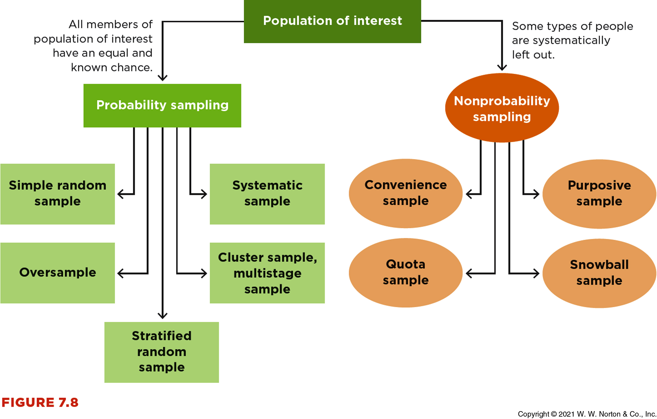
Combining Techniques

Slide 18
Survey of My Amazing Class
Discuss with A Partner:
What problems do you see in this survey?
What principles from Chapter 6 can you find in these problems?
How might you revise the questions to make them more appropriate?

Slide 19
Determining Priorities

Slide 20
Interrogating External Validity: What Matters Most?
In a frequency claim, external validity is a priority.
Cases where external validity is a lower priority
Nonprobability samples in the real world
Nonprobability samples in research studies

Slide 21
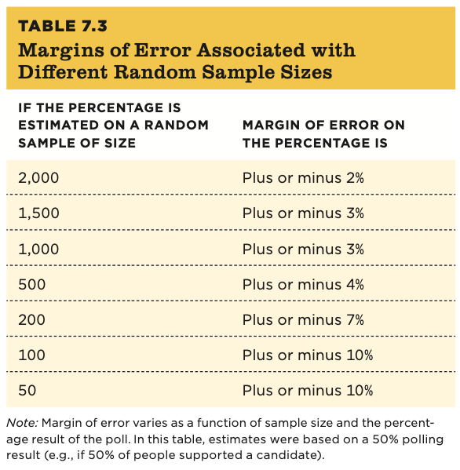
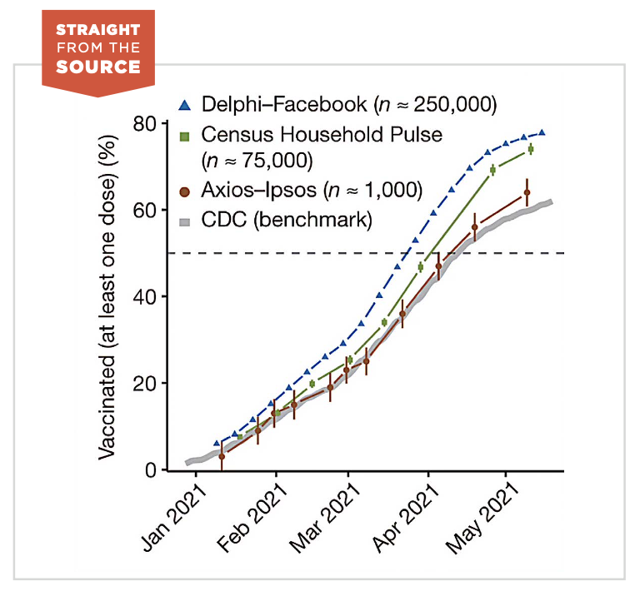
Interrogating External Validity: What Matters Most?
  Sampling technique, not sample size, determines external validity.
    Increasing sample size narrows us in on our point estimate (smaller margin of error)
    The sample technique makes the point estimate more generalizable

